Slide 1
HR DATA ANALYSIS PROJECT
DEPI
GRADUATION PROJECT

Slide 2
Contents
TEAM INTRODUCTION | TEAM MEMBERS
PROJECT DETAILS | DETAILED STEPS OF THE WHOLE PROCESS
PROJECT OUTCOME | THE INSIGHTS AND RESULTS OF THE DATA ANALYSIS CONDUCTED

Slide 3
TEAM MEMBERS
04
02
05
01
Mostafa Mahmoud
Tasnim Emad
Mohamed Gomaa
Mislyar Hamdy
03
Sandy Safwat
06
Wedad Sayed

Slide 4
PROJECT DETAILS
1
DATA CLEANING
2
DAX FUNCTIONS
3
VISUALIZING CHARTS

Slide 5
1
DATA CLEANING
Data Cleaning & Preparation
Before diving into analysis, ensuring our data is clean and well-structured is crucial for accurate insights. In this section, we will walk through the cleaning process, addressing missing values, duplicate records, and inconsistencies to enhance data quality. By refining the dataset, we lay the foundation for meaningful visualizations and reliable decision-making.

Slide 6
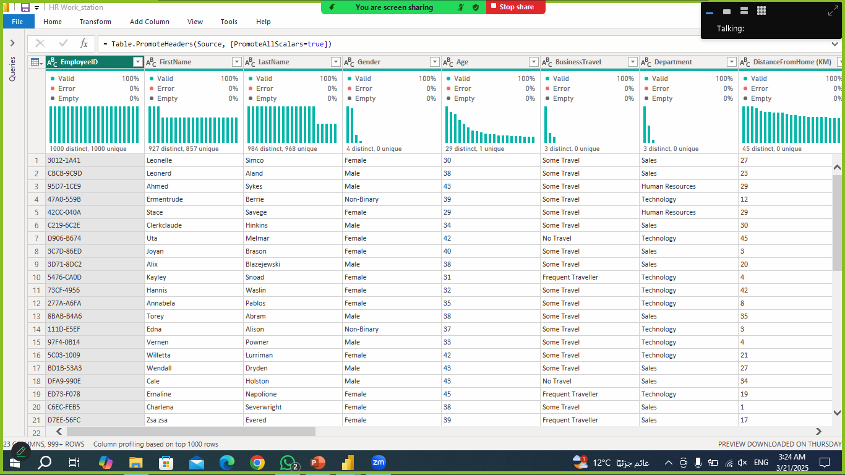
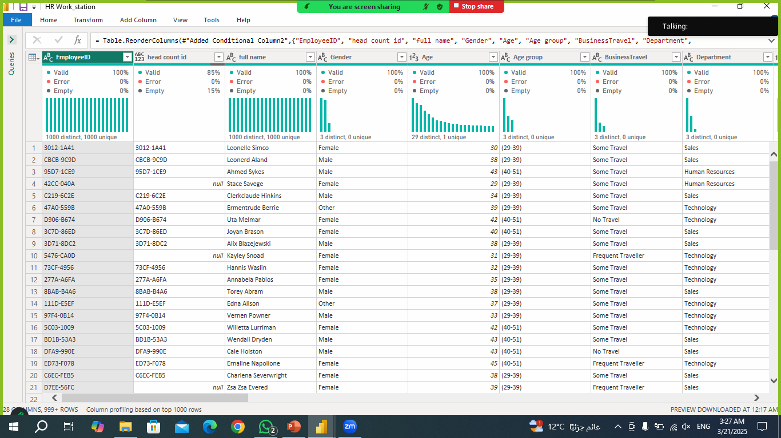
Before
1
DATA CLEANING
Employee sheet
After

Slide 7
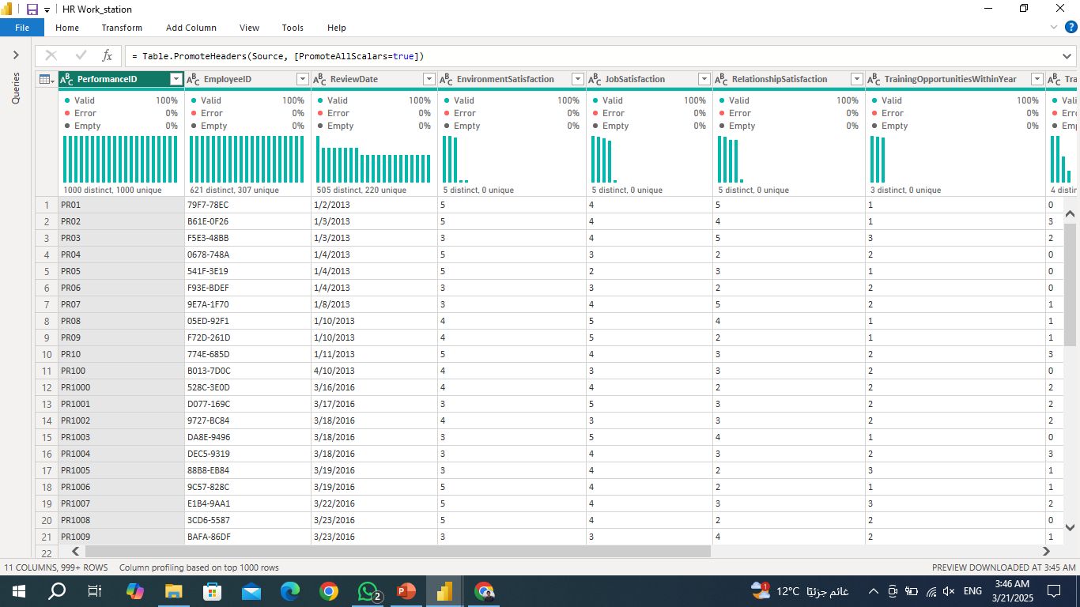
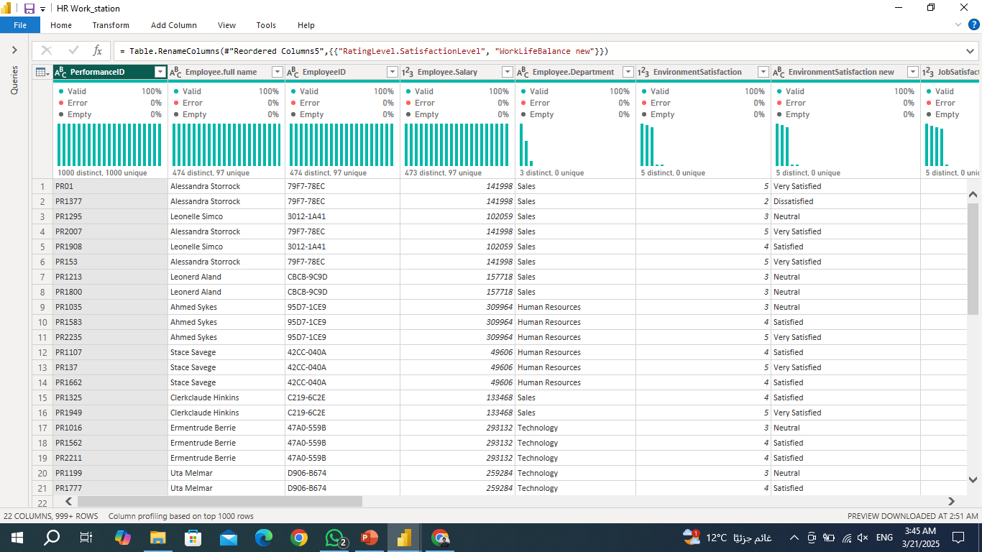
Before
1
DATA CLEANING
Performance Rating sheet
After

Slide 8
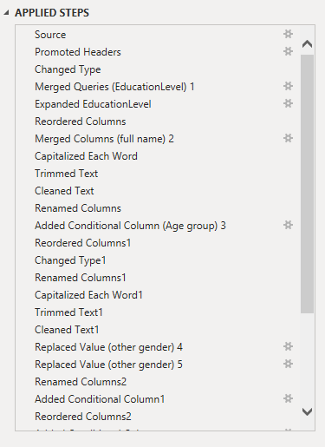
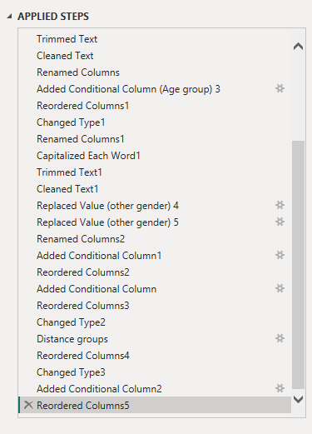
Applied Steps
1
DATA CLEANING
Employee sheet

Slide 9
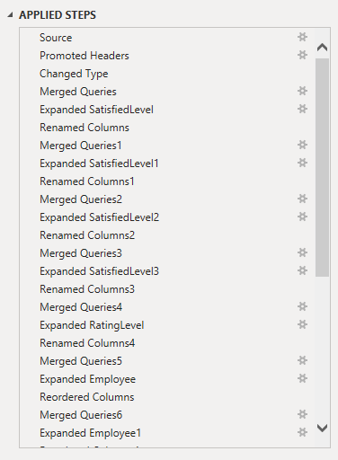
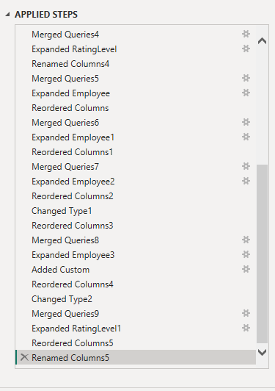
Applied Steps
1
DATA CLEANING
Performance Rating sheet

Slide 10
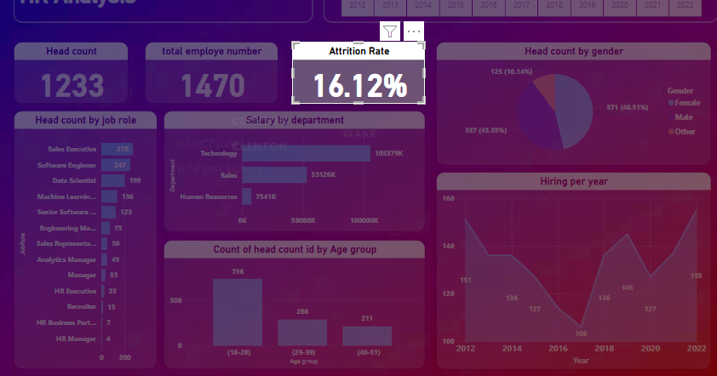
2
DAX FUNCTIONS
Attrition Rate = DIVIDE(COUNTROWS(FILTER('Employee', 'Employee'[Attrition] = "Yes")), [Total Employees], 0)
Average Distance from Home = AVERAGE(Employee[DistanceFromHome (KM)])

Slide 11
2
DAX FUNCTIONS
Average Salary = AVERAGE(Employee[Salary])
Average Years with Current Manager = AVERAGE(Employee[YearsWithCurrManager])
Employees by Gender Female = COUNTROWS(FILTER(Employee, Employee[Gender] = "Female"))

Slide 12
2
DAX FUNCTIONS
Average Salary = AVERAGE(Employee[Salary])
Average Years with Current Manager = AVERAGE(Employee[YearsWithCurrManager])
Employees by Gender Female = COUNTROWS(FILTER(Employee, Employee[Gender] = "Female"))

Slide 13
2
DAX FUNCTIONS
Employees in Department human resourses = COUNTROWS(FILTER(Employee, Employee[Department] = "Human Resources"))
Total Employees = COUNTROWS(Employee)
Employee Count by Performance =
CALCULATE(COUNTROWS('PerformanceRating'), 'PerformanceRating'[ManagerRating new] = "Exceeds Expectation")

Slide 14
2
DAX FUNCTIONS
Employee Satisfaction Score =
AVERAGEX(
'PerformanceRating',
SWITCH(TRUE(),
'PerformanceRating'[JobSatisfaction new] = "Satisfied", 3,
'PerformanceRating'[JobSatisfaction new] = "Neutral", 2,
'PerformanceRating'[JobSatisfaction new] = "Dissatisfied", 1,
'PerformanceRating'[JobSatisfaction new] = "Very Satisfied", 4,
'PerformanceRating'[JobSatisfaction new] = "Very Dissatisfied", 5,
0
)
)

Slide 15
3
VISUALIZATION CHARTS
Data Visualization
With a clean and structured dataset, we can now transform raw data into meaningful insights through visualizations. This section showcases key charts and dashboards that highlight trends, patterns, and performance metrics. By using Power BI’s dynamic visual tools, we make complex data easier to understand, enabling informed decision-making at a glance.

Slide 16
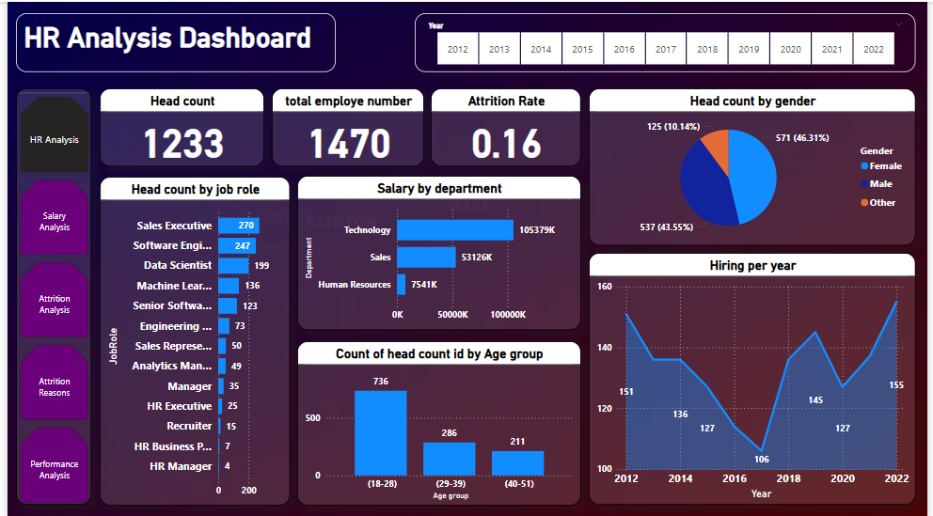
3
VISUALIZATION CHARTS

Slide 17
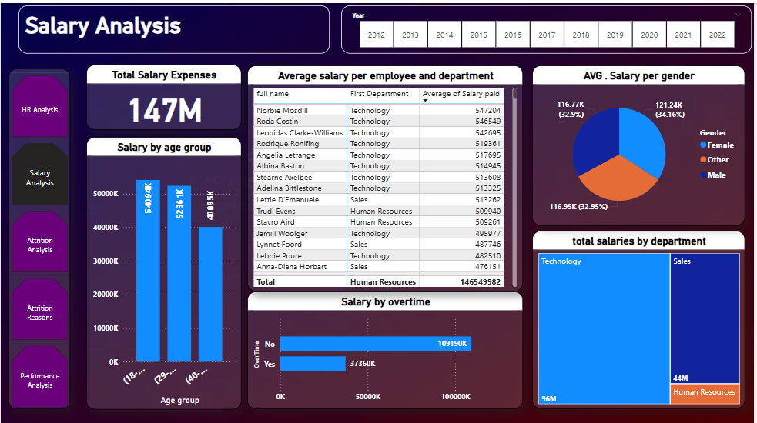
3
VISUALIZATION CHARTS

Slide 18
3
VISUALIZATION CHARTS

Slide 19
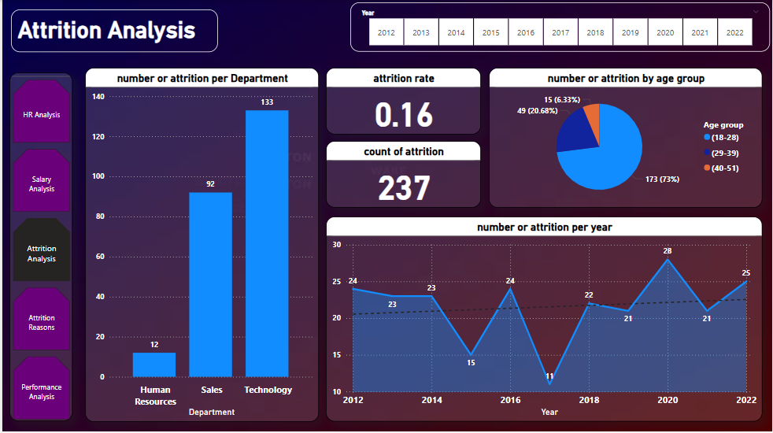
3
VISUALIZATION CHARTS

Slide 20
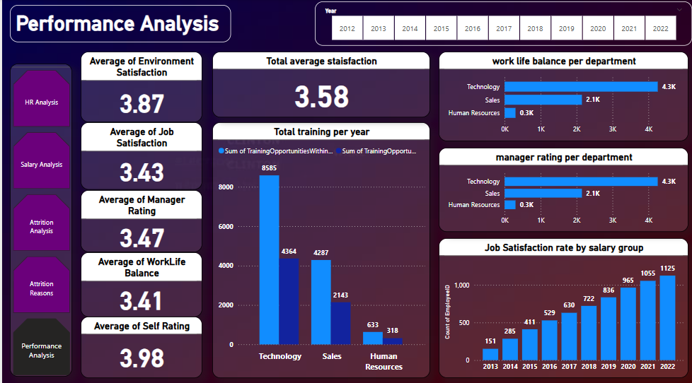
3
VISUALIZATION CHARTS

Slide 21
Project links
Power BI file
GitHub link
drive link
Service

Slide 22
Thanks!
https://depi.gov.eg/content/home

